Slide 1

The Endings Project @ UVic
Concluding, Archiving, and Preserving Digital Projects for Long-Term Usability
@RiskNorth 2, Montreal QC, November 2018
Lisa Goddard
University of Victoria Libraries

Slide 2

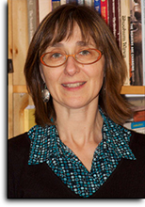
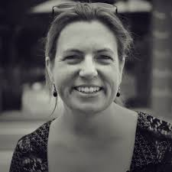

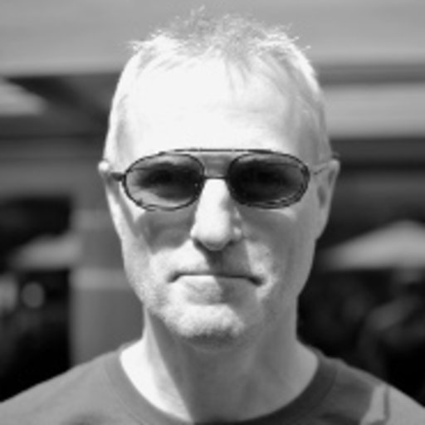
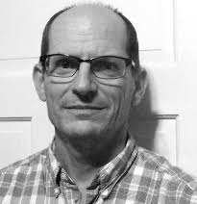
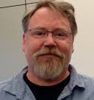

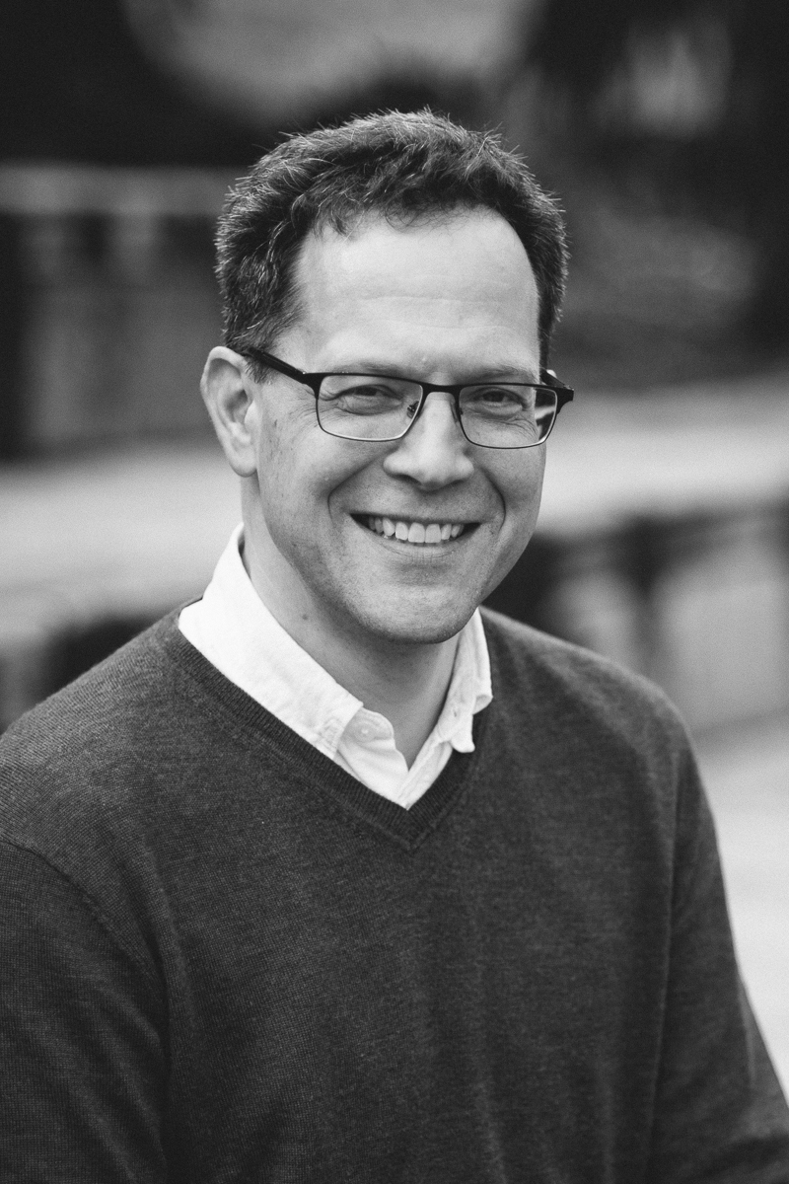
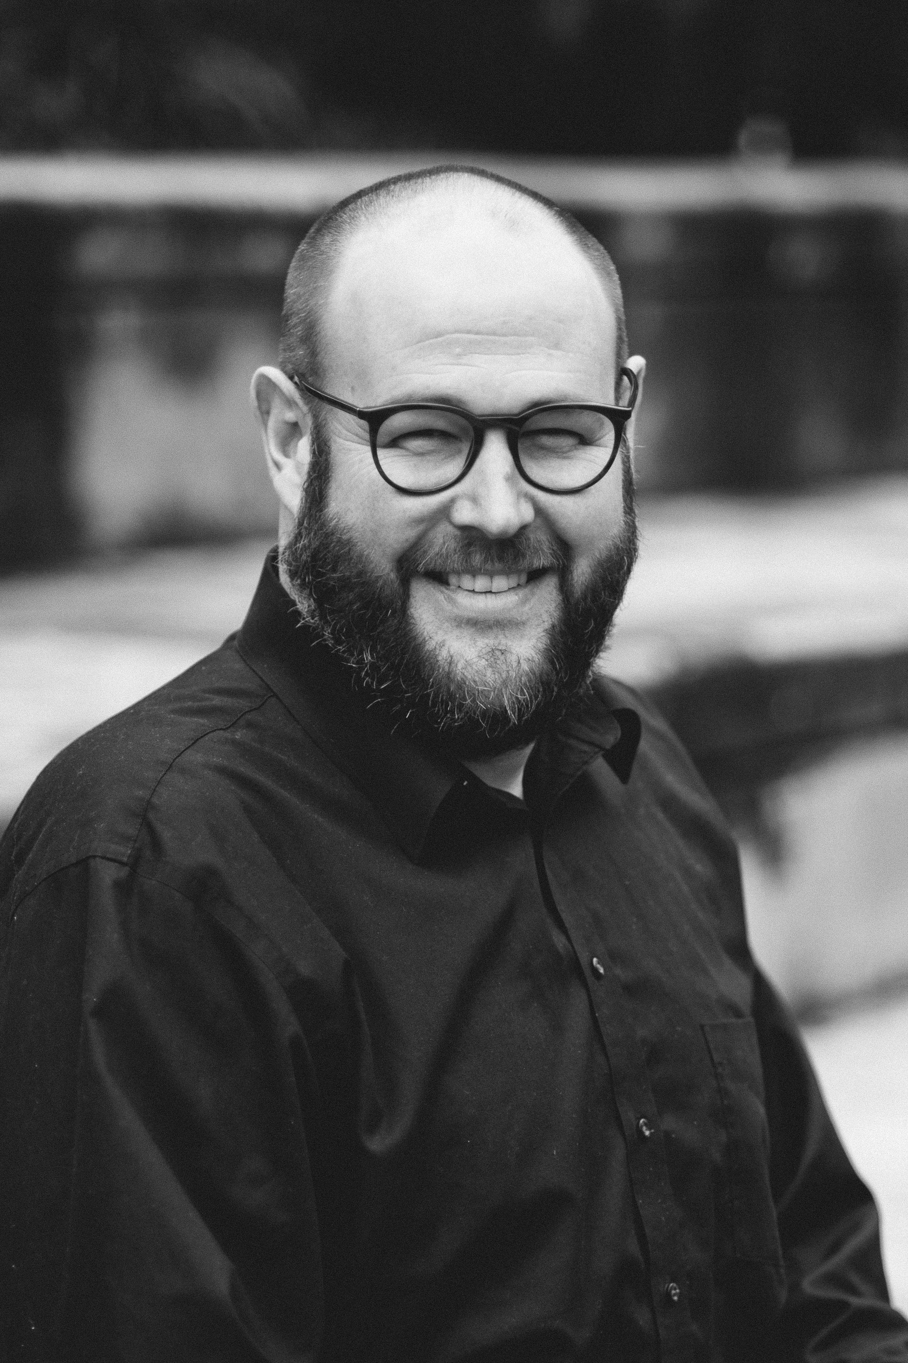
ENDINGS - SSHRC Insight - $192,000 - 4 Years
HUMANITIES
PROFESSORS
English
French
Linguistics
Claire Carlin
Ewa Czaykowska-Higgins
Janelle Jenstad
Elizabeth Grove-White
HUMANITIES
COMPUTING
Martin Holmes
Stewart Arneil
Greg Newton
LIBRARIANS
Lisa Goddard
John Durno
Matt Huculak

Slide 3
Research Questions
How DO digital humanities projects conclude?
How SHOULD digital humanities projects conclude?

Slide 4
How DO digital humanities projects conclude?
Survey of DH project leads: 127 responses
In-depth interviews: 27
Short answer: They don’t.

Slide 5
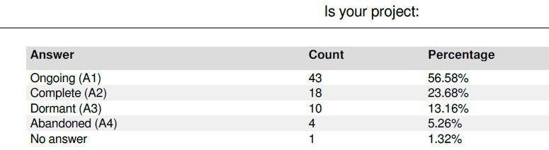
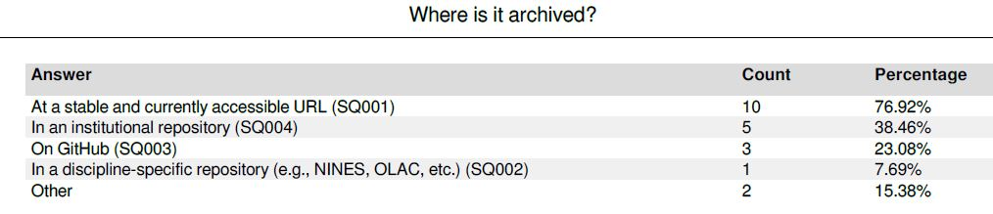
Survey Results (Preliminary)

Slide 6

Reported Challenges (Preliminary)
Funding
Institutional support
Hosting
Documentation
Team turnover
Project management
Academic merit
Rights
Notes:
Highlighted challenges = areas for library intervention

Slide 7
How SHOULD digital humanities projects conclude?
The project team will finish, document, and archive four DH projects at UVic.
Robert Graves Diary Project
The Nxaʔamxčín Database and Dictionary
Le mariage sous l’Ancien Régime
The Map of Early Modern London
Notes:
From our four case-study projects, we know that, for digital editions and text collections, almost all of the current functionality which is dependent on server-side technologies such as XML databases can be reproduced using pure HTML5, CSS and JavaScript.

Slide 8

Archival copy: HTML5, CSS and JavaScript
Write code modules to generate all the output pages needed.
OR
Dynamic Site
Process a version of the actual existing site, using a web crawler to create a static version.
Static Site
Notes:
Hypertext Markup Language (HTML), Cascading Style Sheets (CSS) and Javascript (JS) are all managed by well-funded standards bodies, with a history of slow but steady evolution and standardization, and have universal support across computing browsers and platforms. Using HTML5, CSS and JS promises to be the most robust and successful combination of web technologies yet.
JavaScript-based client-side search engine divorced from the live web, based on pre-computed indexes. Leverage all possible encoded metadata so that it will be optimally indexed by present and future web search engines. Library host offers Lucene/Solr indexing.
JavaScript-based client-side search engine divorced from the live web, based on pre-computed indexes. The FullProof project (https://github.com/reyesr/fullproof) provides a working example of this approach. For larger sites we will investigate and test methods to configure our static web content, leveraging all possible encoded metadata so that it will be optimally indexed by present and future web search engines, on the assumption that in addition to HTML, CSS and JS, search engines of some kind will remain an intrinsic part of the Web.

Slide 9
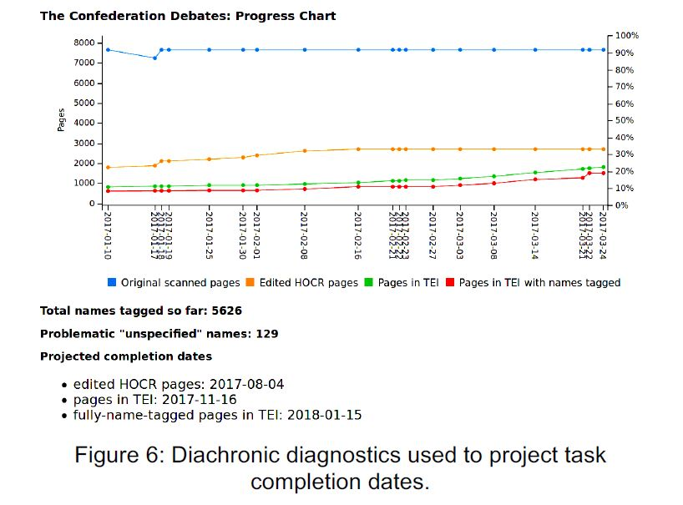
Diagnostic Tools
Ensure quality
Track progress
Notes:
Project management tools to ensure quality, produce documentation, and measrue progress towards completion.

Slide 10
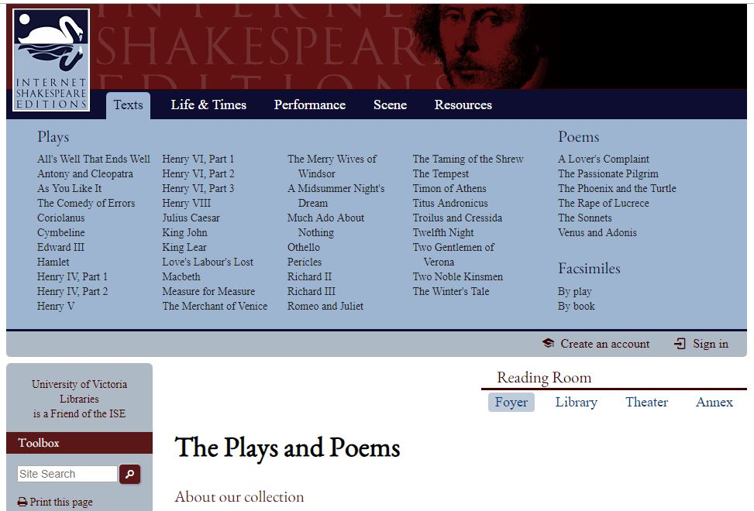
Compliance Guidelines
ENDINGS COMPLIANT
Notes:
http://contentdm.library.uvic.ca/cdm/compoundobject/collection/collection49/id/20

Slide 11
Endings Project Outputs
Four (or more) digital editions finished and archived.
Diagnostic tools
- quality control
- help track tasks to completion
- produce documentation
Set of principles/guidelines for ending and archiving projects.
Preservation readiness assessment quiz.
Training materials for DH researchers.

